Slide 1

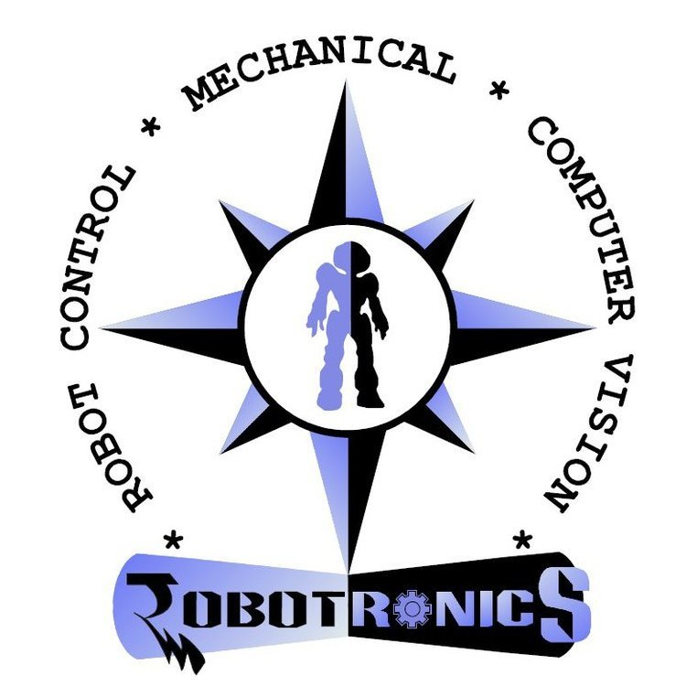

Centre for Robotics Research
HUMAN TRACKING IN LOW ILLUMINATION
Dr. Jharna Majumdar,
Dean R&D,
Center for Robotics Research
NMIT, Bengaluru.
ADARSH C 1NT15EC007
HARSHPREET SINGH 1NT15EC056
RAHUL V C 1NT15EC128
THIS PROJECT IS CONDUCTED UNDER CENTER FOR ROBOTIC RESEARCH
CENTER FOR ROBOTICS RESEARCH

Slide 2
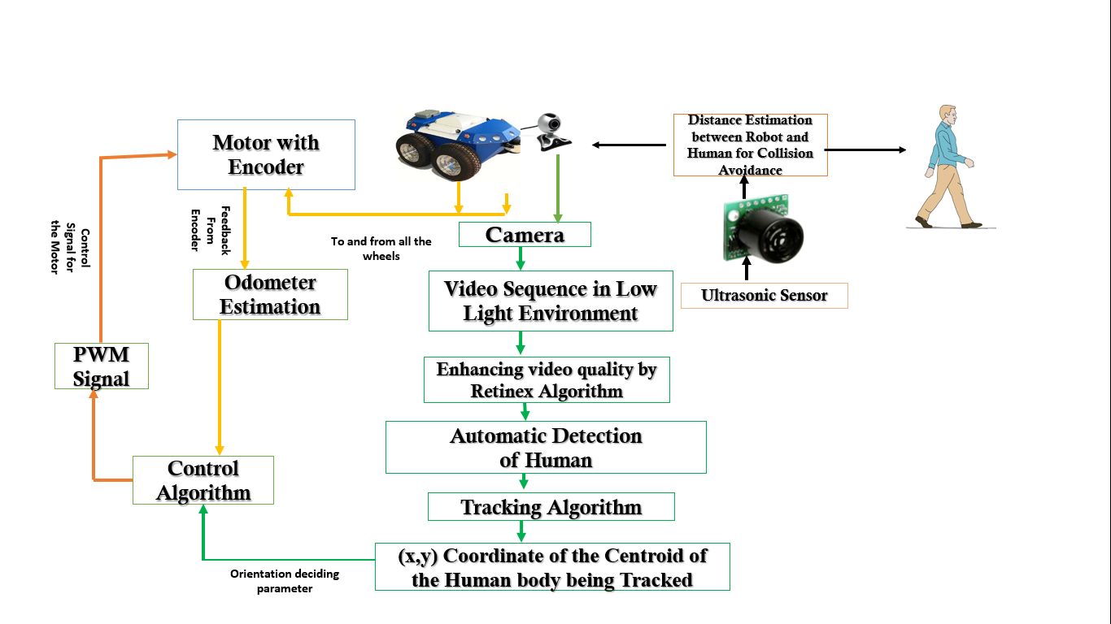
Objective
CENTER FOR ROBOTICS RESEARCH
1

Slide 3
Origin of Work
1. Dr. Jharna Majumdar, Dr. P Nagabhushan, Mili Nandi, “RetinexAlgorithm with reduced halo artifacts”,
Defence Science Journal, Vol.61, No. 6, November 2011, pp. 559-566, DOI: 10.14429/dsj.61.753
2. Rahman, Z. Jobson, D.J. & Woodell, G.A. Multi-Scale Retinex for color image enhancement. In Proceeding
of the IEEE International Conference on Image Processing(ICIP), 1996.
The above papers have been highly referenced in the research field of Retinex.
These papers provide a good explanation of Retinex by summarizing all the work done in this field.
CENTER FOR ROBOTICS RESEARCH
2

Slide 4
Introduction
Retinex is a theoretical model of the human retinal imaging imitation.
A method bridging the gap between images and the human observation of scenes.
Retinex can achieve
Sharpening
Color constancy processing
Dynamic range compression
Retinex Techniques
Single Scale Retinex (SSR)
Multi-Scale Retinex (MSR)
Multi-Scale Retinex with Colour Restoration (MSRCR)
CENTER FOR ROBOTICS RESEARCH
3

Slide 5
Literature survey
Reference:
1. Dr. Jharna Majumdar, Dr. P Nagabhushan, Mili Nandi, “RetinexAlgorithm with reduced halo artifacts”,
Defence Science Journal, Vol.61, No. 6, November 2011, pp. 559-566, DOI: 10.14429/dsj.61.753
2. Rahman, Z.; Jobson, D.J. & Woodell, G.A. MultiScale Retinex for color image enhancement. In Proceeding
of the IEEE International Conference on Image Processing(ICIP), 1996.
Retinex theory was first brought forward by Edwin H. Land in 1977, and later Jobson.et put forward two algorithms, the Single-Scale Retinex (SSR) and the Multi-Scale Retinex (MSR).
Among the various methods that have been put forward to solve problems of bad image acquisition, caused due to uneven illumination, like adaptive histogram equalization, gradient field image enhancement etc. the Retinex has become a research hotspot because it could achieve an appropriate balance between dynamic range compression, sharpening and color constancy .
Colour constancy means that the perceived colours are relatively constant under varying illumination conditions. This is a powerful algorithm especially for the visibility improvement of the dark regions which makes it useful for processing the scenes of a dark environment.
CENTER FOR ROBOTICS RESEARCH
4

Slide 6
Literature survey
The Brightness Preserving Bi-Histogram Equalization (BBHE) was proposed by Yeong Kim, to enhance the contrast of a dark image. Simulation results also demonstrate the brightness-preserving function of the BBHE while enhancing contrasts.
Equal area dualistic sub-image histogram equalization (DSIHE) algorithm was proposed that could not only enhance image information effectively but also keep the original image luminance.
Contrast limited adaptive histogram equalization (CLAHE) was proposed in order to improve the visibility level of foggy image or video.
After these, a different approach of using gradient domain instead of intensity gradient was proposed for enhancement. This method can enhance the object contrast uniformly, and suppress the noise with no artifacts. Homophoric filtering technique was also implemented for enhancement. It helped to significantly improve face recognition performance on images with difficult illumination conditions.
However, the Retinex algorithm is the most suitable for enhancement compared to the above techniques.
CENTER FOR ROBOTICS RESEARCH
5

Slide 7
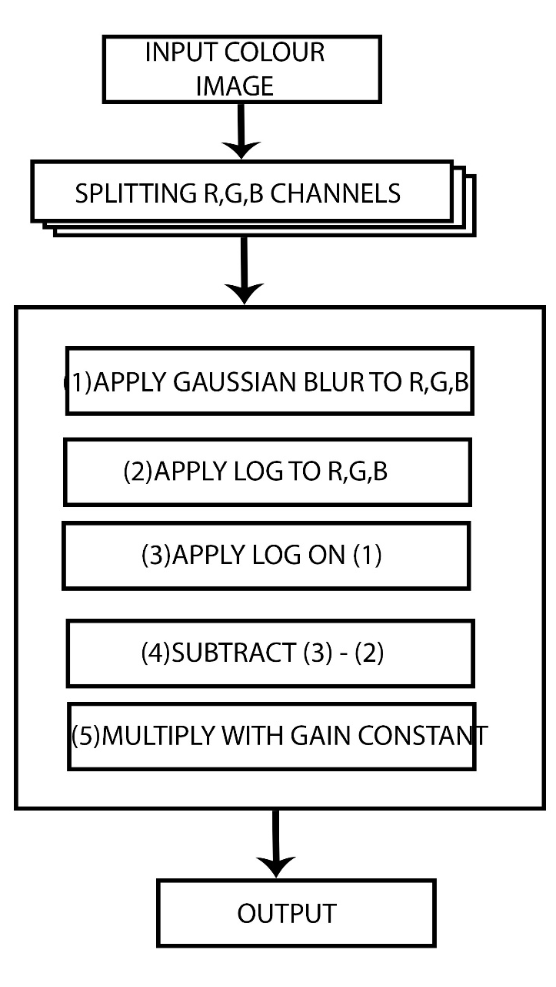
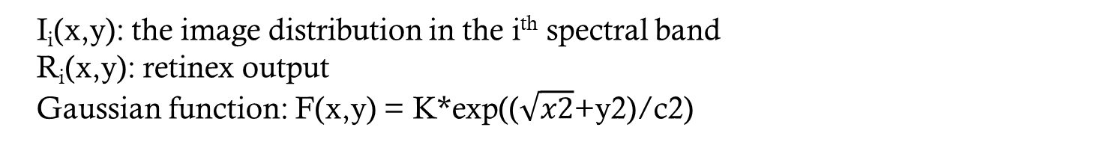
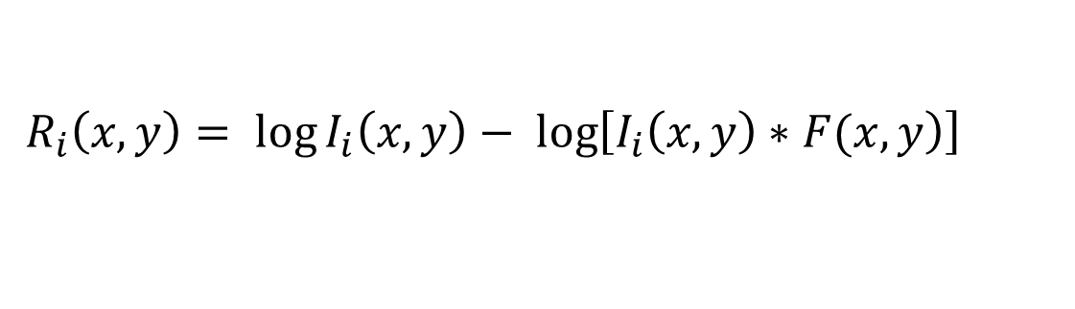
Single Scale Retinex(SSR)
ALGORITHM:
The input image stored in an array.
The individual color components are separated and stored in individual arrays as red (R(x,y)), green (G(x,y)) and blue (B(x,y)).
$$R_{i}\left(x, y\right)= \log{I_{i}\left(x, y\right)− \log\left[\left.I_{i}\left(x, y\right)∗F(x, y\right)\right]}$$
I_{i}(x,y): the image distribution in the i^{th} spectral band
R_{i}(x,y): retinex output
Gaussian function: F(x,y) = K*exp(($\sqrt{x2}$+y2)/c2)
C is the Gaussian surround space constant
The color components are recombined to get the processed output image
CENTER FOR ROBOTICS RESEARCH
6

Slide 8
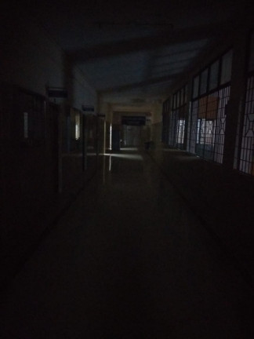
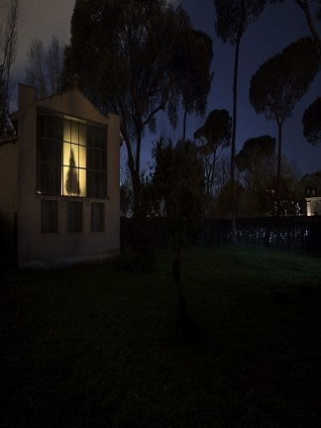
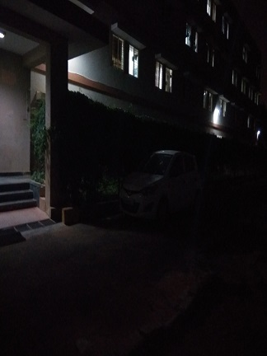
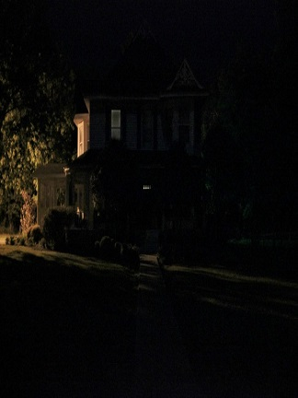
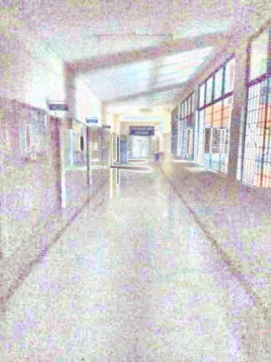
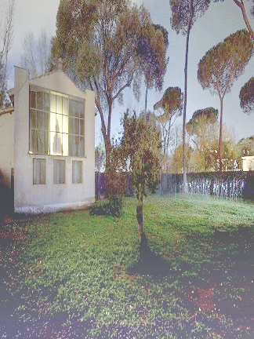
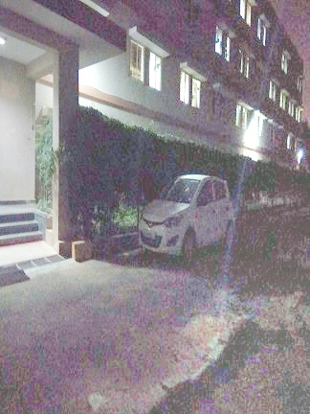
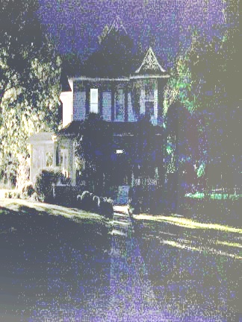
Output Of SSR
Input
Output
CENTER FOR ROBOTICS RESEARCH
7

Slide 9
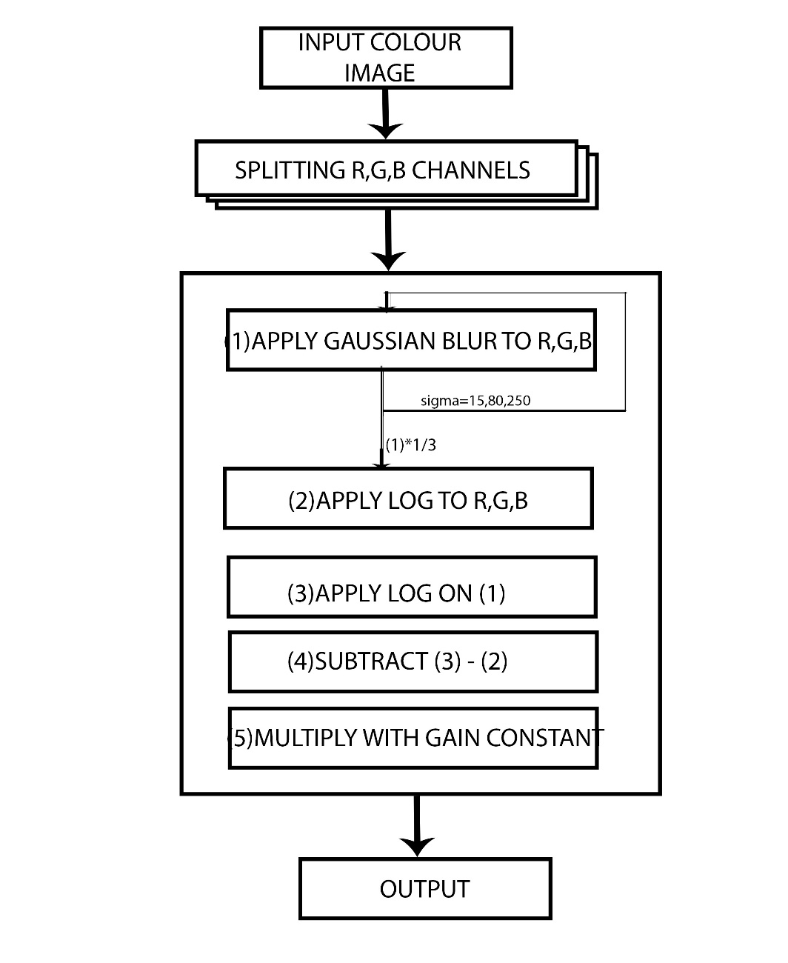
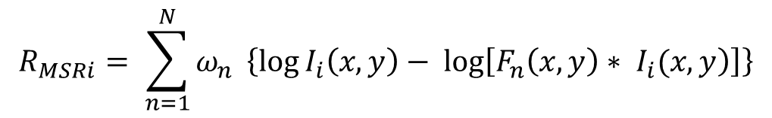
Multi-scale Retinex(MSR)
ALGORITHM:
$$R_{MSRi}= \sum_{n=1}^{N}{ω_{n}} \left\{\log{I_{i}\left(x, y\right)− \log\left[\left.F_{n}\left(x, y\right)∗ I_{i}(x, y\right)\right]}\right\}$$
N: number of scales,
ω_{n}: weight associated with the nth scale
Empirical value:
N=3, ω_{n}=1/3, for RGB
C = 15, 80 and 250 correspondingly for each scale in F_{n}
Better than SSR in balance of dynamic compression.
CENTER FOR ROBOTICS RESEARCH
8

Slide 10
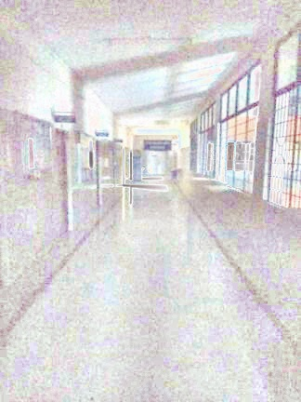
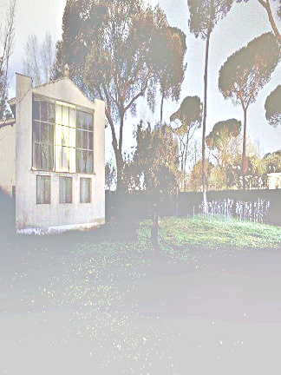
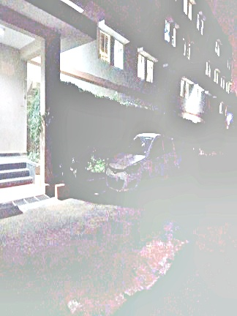
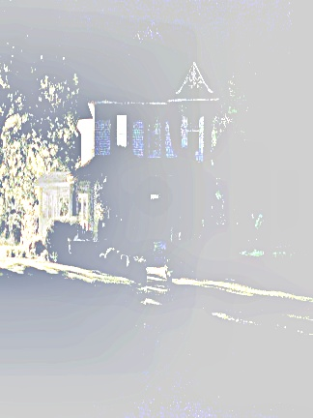
Output Of MSR
Input
Output
CENTER FOR ROBOTICS RESEARCH
9

Slide 11
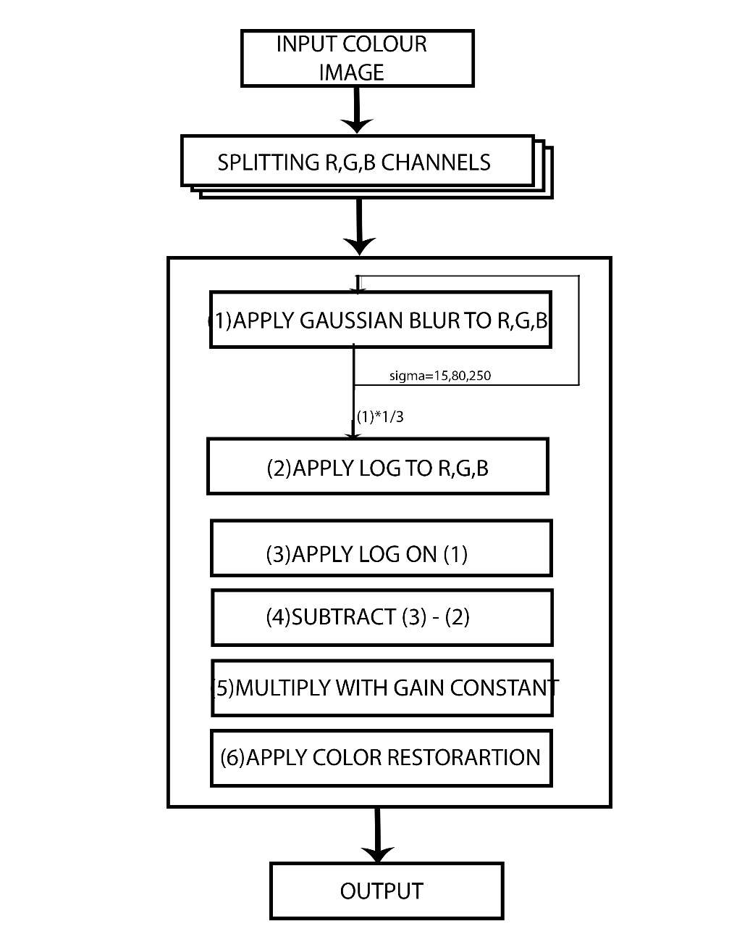
Multi-scale Retinex With Color Restoration (MSRCR)
ALGORITHM:
The color restoration is calculated using the expression
C_{i}(x,y) = β{log[α I_{i} (x,y)] – log[ Σ I_{i}(x,y)]}
Where
β- Gain Constant
α- Controls the strength of non-linearity
The Final representation of MSRCR is represented as
R _{MSRCRi} (x, y) = G [C_{i} (x, y) * R_{MSRi} (x, y) + b
Where
G- Gain Constant and
b- Gain Offset value
$$R_{MSRCRi}\left(x,y\right)=C_{i}\left(x,y\right)R_{MSRi}(x,y)$$
CENTER FOR ROBOTICS RESEARCH
10

Slide 12
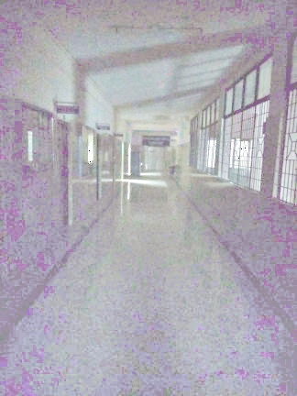
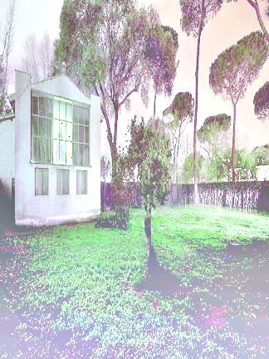
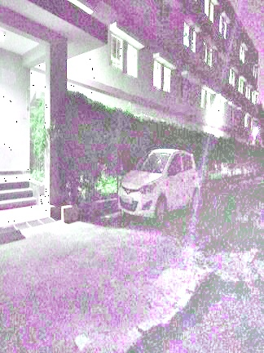
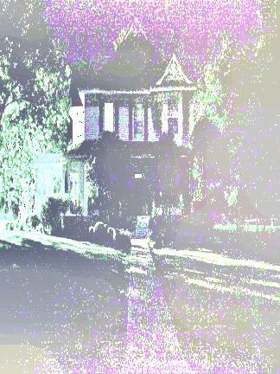
Output Of MSRCR
Input
Output
CENTER FOR ROBOTICS RESEARCH
11

Slide 13
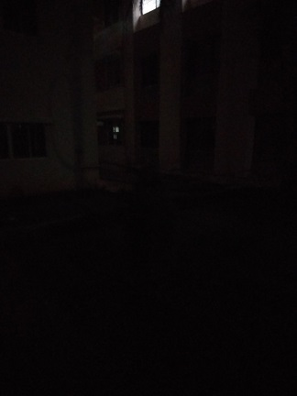
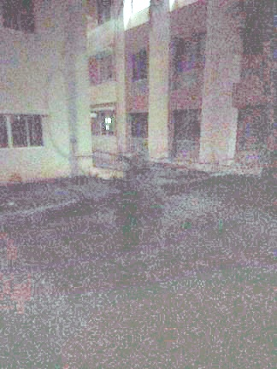
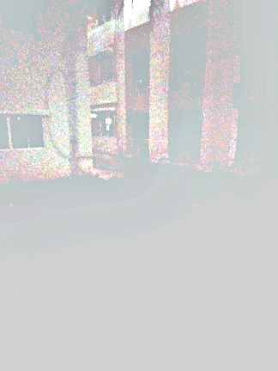
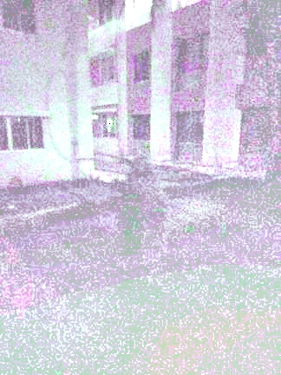
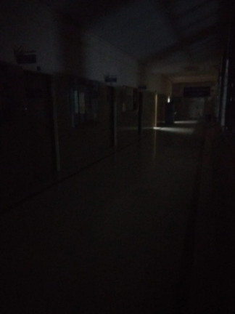
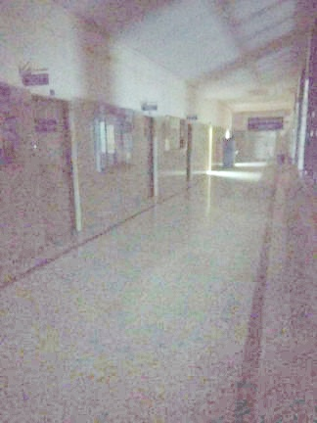
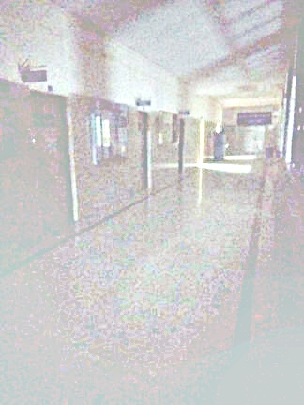
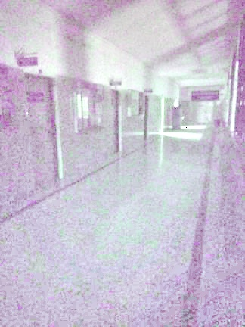
Comparison Of SSR, MSR & MSRCR
Input
SSR output
MSR output
MSRCR output
CENTER FOR ROBOTICS RESEARCH
12

Slide 14
QUALITY METRICS ANALYSIS OF RETINEX
CENTER FOR ROBOTICS RESEARCH
13

Slide 15
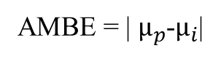
Quality Metric Parameters
QI | DESCRIPTION | EQUATIONS
EER | The entropy error rate (EER) is a measure of distribution of image information.
GC | Global contrast is second central moment of histogram divided by total number of pixels
QI | Quality index is based on statistical features of gray level histogram of an image
AMBE | Absolute mean brightness error measures the deviation of the mean of processed image from the mean of input image.
RE | The relative entropy of p with respect to q is then defined as the summation of all possible states of the system
AMBE = | $µ_{p}$-$µ_{i}$|
CENTER FOR ROBOTICS RESEARCH
14

Slide 16
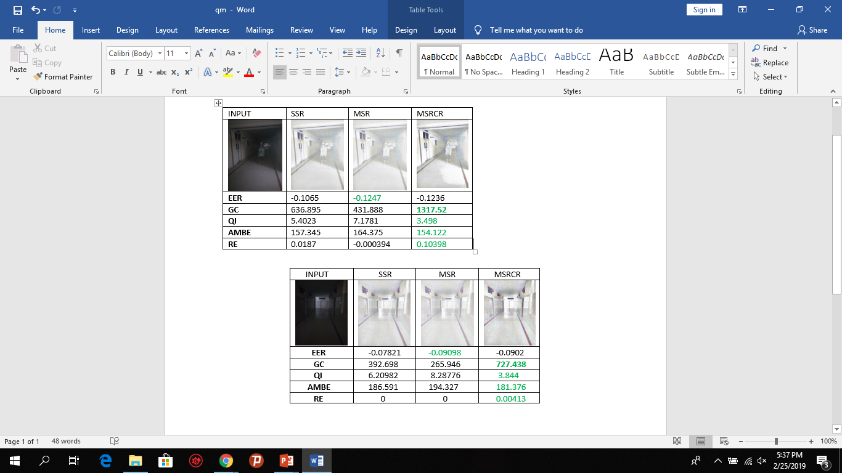

Quality Metric Analysis
According to the quality metric analysis we can see that MSRCR perform better than SSR and SSR is better than MSR
MSRCR > SSR > MSR
CENTER FOR ROBOTICS RESEARCH
15

Slide 17
TIMING ANALYSIS OF VIDEO
SYSTEM SPECS:
CPU - Intel Core i5-6200U 79.
GPU - AMD Radeon R5 M315
(2GB DDR3) 175.
Display - 15.6”, HD (1366 x 768),
TN.HDD/SSD. 1TB HDD.
RAM - 2x 4GB DDR3L, 1600 MHz
OS - Windows
CENTER FOR ROBOTICS RESEARCH
16

Slide 18
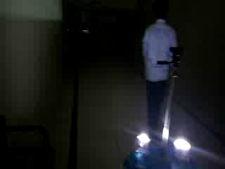
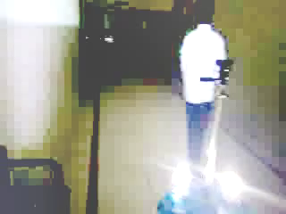
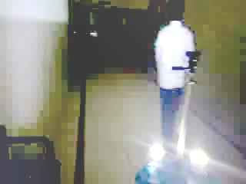
SSR Output In Video
SSR WITHOUT
MULTI-THREADING
SSR WITH
MULTI-THREADING
INPUT VIDEO
Total Frames | Time (sec) | FPS
100 | 9.2572 | 11
200 | 19.8131 | 11
500 | 46.1363 | 11
900 | 86.4311 | 11
Total Frames | Time (sec) | FPS
100 | 3.232 | 31
200 | 6.358 | 32
500 | 15.724 | 32
900 | 28.2399 | 32
CENTER FOR ROBOTICS RESEARCH
17

Slide 19
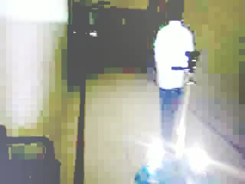
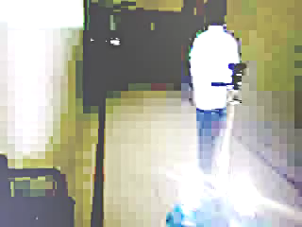
MSR Output In Video
MSR WITHOUT
MULTI-THREADING
MSR WITH
MULTI-THREADING
INPUT VIDEO
Total Frames | Time (sec) | FPS
100 | 14.6376 | 7
200 | 28.0541 | 8
500 | 68.0344 | 8
900 | 123.195 | 8
Total Frames | Time (sec) | FPS
100 | 5.2397 | 20
200 | 10.573 | 19
500 | 25.0743 | 20
900 | 42.7988 | 21
CENTER FOR ROBOTICS RESEARCH
18

Slide 20
MSRCR Output In Video
MSRCR WITHOUT
MULTI-THREADING
MSRCR WITH
MULTI-THREADING
INPUT VIDEO
Total Frames | Time (sec) | FPS
100 | 13.4081 | 7
200 | 27.0247 | 8
500 | 63.9982 | 8
900 | 115.159 | 8
Total Frames | Time (sec) | FPS
100 | 5.856 | 17
200 | 12.532 | 16
500 | 31.253 | 16
900 | 52.94 | 17
CENTER FOR ROBOTICS RESEARCH
19

Slide 21
Comparison Between SSR, MSR & MSRCR
SSR WITH
MULTI-THREADING
MSR WITH
MULTI-THREADING
MSRCR WITH
MULTI-THREADING
Total Frames | Time (sec) | FPS
100 | 3.232 | 31
200 | 6.358 | 32
500 | 15.724 | 32
900 | 28.2399 | 32
Total Frames | Time (sec) | FPS
100 | 5.2397 | 20
200 | 10.573 | 19
500 | 25.0743 | 20
900 | 42.7988 | 21
Total Frames | Time (sec) | FPS
100 | 5.856 | 17
200 | 12.532 | 16
500 | 31.253 | 16
900 | 52.94 | 17
CENTER FOR ROBOTICS RESEARCH
20

Slide 22
OPTIMIZATION ON EMBEDDED BOARDS
CENTER FOR ROBOTICS RESEARCH
21

Slide 23
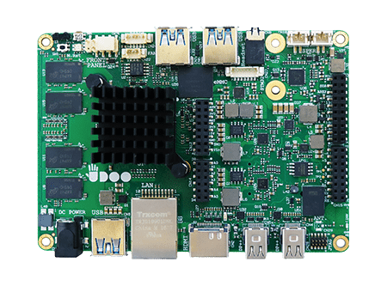
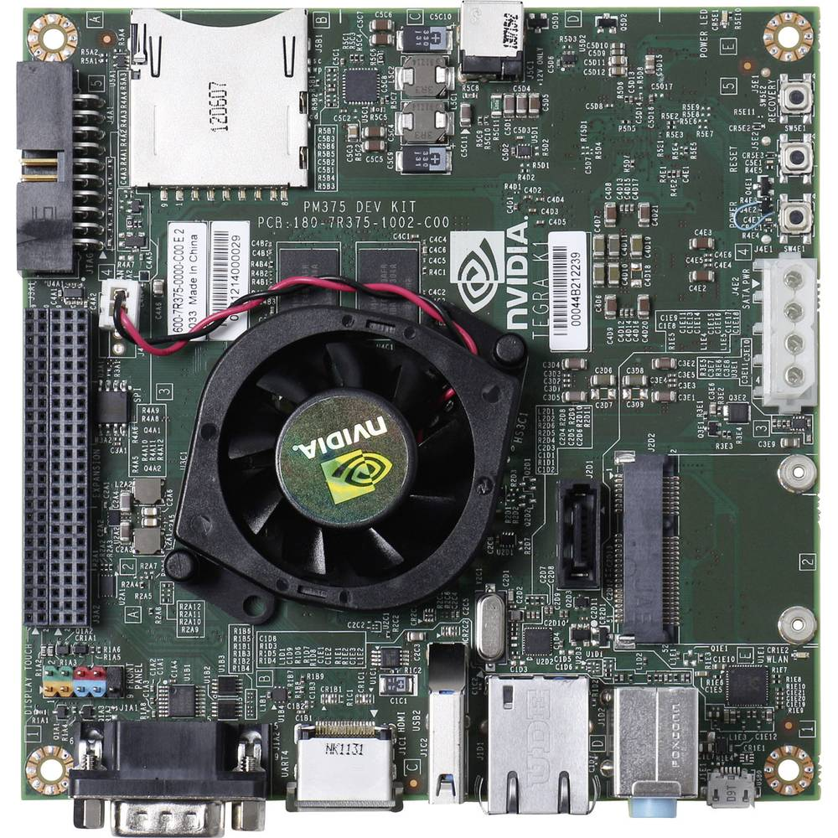
Hardware Configuration
UDOO X86 Ultra:
Tegra K1 SOC:
CPU: Intel Pentium N3710 2.56Ghz Integrated graphics: Intel HD Graphics 405, up to 700MHz 16 execution units RAM: 8GB DDR3L Dual Channel
Storage: 32GB EMMC Storage
GPU: NVIDIA Kepler "GK20a" GPU with 192 SM3.2 CUDA cores
CPU: NVIDIA "4-Plus-1" 2.32GHz ARM quad-core Cortex-A15 CPU
DRAM: 2GB DDR3L 933MHz EMC x16 using 64-bit data width
Storage: 16GB fast eMMC 4.51
CENTER FOR ROBOTICS RESEARCH
22

Slide 24
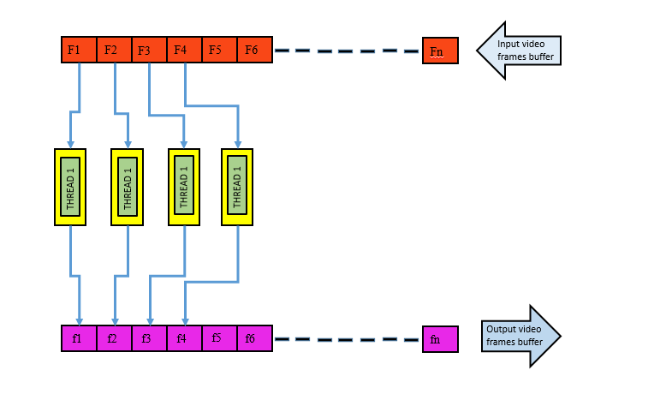
Memory Modelling For Optimization On Udoo
SSR
MSR
MSRCR
No. of threads | FPS
2 | 20
3 | 25
4 | 33
No. of threads | FPS
2 | 15
3 | 21
4 | 28
No. of threads | FPS
2 | 15
3 | 17
4 | 20
CENTER FOR ROBOTICS RESEARCH
23

Slide 25
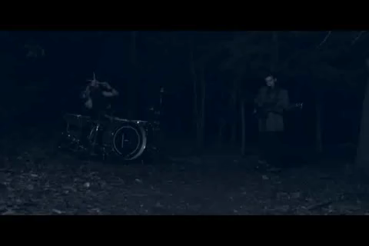
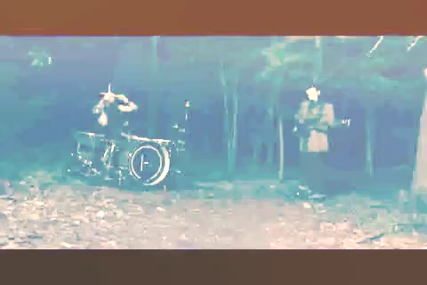
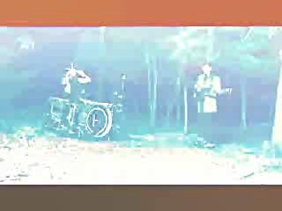
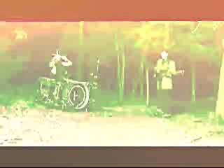
Output On Udoo Board
Category:
Corridor
Category:
Entertainment
INPUT VIDEO
SSR OUTPUT
MSR OUTPUT
MSRCR OUTPUT
CENTER FOR ROBOTICS RESEARCH
24

Slide 26
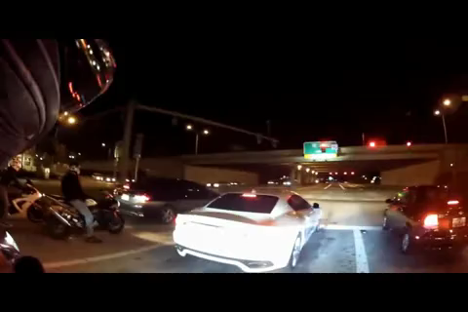
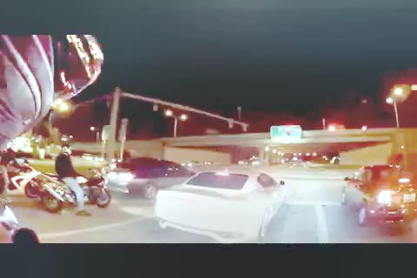
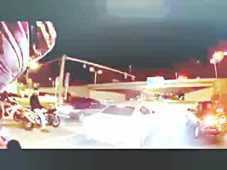
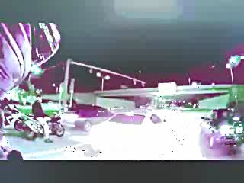




Output On Udoo Board
Output On Udoo Board
Category:
Sports
Category:
Outdoor
INPUT VIDEO
SSR OUTPUT
MSR OUTPUT
MSRCR OUTPUT
CENTER FOR ROBOTICS RESEARCH
25

Slide 27
Retinex Output On Udoo Board
SSR:
(1)
MSR:
(1)
MSRCR:
(1)
Total Frames | FPS
100 | 4
200 | 4
500 | 4
900 | 4
Total Frames | FPS
100 | 2
200 | 2
500 | 2
900 | 2
Total Frames | FPS
100 | 2
200 | 2
500 | 2
900 | 2
(3)
(3)
(3)
Total Frames | FPS
100 | 20
200 | 19
500 | 20
900 | 20
Total Frames | FPS
100 | 33
200 | 32
500 | 34
900 | 34
Total Frames | FPS
100 | 28
200 | 28
500 | 29
900 | 28
(2)
(2)
(2)
Total Frames | FPS
100 | 29
200 | 29
500 | 28
900 | 29
Total Frames | FPS
100 | 24
200 | 23
500 | 24
900 | 24
Total Frames | FPS
100 | 14
200 | 15
500 | 14
900 | 15
(1)Without Optimization
(2)With Software Optimization
(3)With Hardware Optimization
CENTER FOR ROBOTICS RESEARCH
26

Slide 28



Simple Processing Flow For GPU Computation
STEP 1
STEP 2
STEP 3
Copy input data from CPU memory to GPU memory
Load GPU program and execute, caching data on chip for performance.
Copy results from GPU memory to CPU memory
CENTER FOR ROBOTICS RESEARCH
27

Slide 29
Heterogenous Computation In Nvidia-tk1
CPU:
PUSHING FRAMES TO GPU
LOG OPERATIONS AND GAIN PARAMETERS
INPUT FRAMES
OUTPUT FRAMES
GPU:
PERFORMING GUASSIAN BLUR
Since implementation of Gaussian kernel is highly parallel and time consuming process we implemented it on GPU to make use of its parallel computation capability.
CENTER FOR ROBOTICS RESEARCH
28

Slide 30

GPU Computation In Nvidia-TK1
SSR
MSR
Total Frames | FPS
100 | 28
200 | 29
500 | 28
900 | 27
Total Frames | FPS
100 | 25
200 | 24
500 | 24
900 | 24
Memory model of Heterogeneous Computing
CENTER FOR ROBOTICS RESEARCH
29

Slide 31



SSR On Mobile Robot
With Tracking
With Robot integration and Tracking
Algorithm |  | Timing Analysis
 |  | Software Optimization | Hardware Optimization
 |  |  | UDOO x86 | Jetson TK1
SSR | Time (ms) | 66.67 | 71.58 | 67.08
 | FPS | 15 | 14 | 15
MSR | Time (ms) | 99.79 | 83.9 | 79.51
 | FPS | 10 | 12 | 14
Algorithm |  | Timing Analysis
 |  | Hardware Optimization
 |  | UDOO x86 | Jetson TK1
SSR | Time (ms) | 83.53 | 77.23
 | FPS | 12 | 13
CENTER FOR ROBOTICS RESEARCH
30

Slide 32









Retinex with Tracking
Input video
SSR output
MSR output
CENTER FOR ROBOTICS RESEARCH
31

Slide 33

Research Outcome
From the following research conducted we successfully drafted a research paper titled as
Real-time Performance Analysis of Retinex Algorithm on Embedded Boards for Robotics Application
CENTER FOR ROBOTICS RESEARCH
32

Slide 34
Conclusions
With respect to time constraints SSR achieves greater FPS than MSR and it runs in real-time compared to MSR and MSRCR.
With respect to quality of the output images MSRCR has better quality in terms of brightness compared to SSR and MSR.
We can achieve higher FPS with Heterogeneous Computation given that communication time between CPU and GPU can be decreased.
CPU of UDOO x86 is more powerful than the Jetson TK1, but if we can utilize the full capability of the CPU-GPU on Jetson TK1 through Heterogeneous computing, then it can outperform UDOO x86
CENTER FOR ROBOTICS RESEARCH
33

Slide 35
References
[1] Lightness and Retinex Theory, Edwin H. Land and John J. McCann, Polaroid Corporation, Cambridge, Massachusetts 02139
[2] Dr. Jharna Majumdar, Prof. Nagabhushan, Mili Nandi, “Retinex Algorithm with reduced halo artifacts”, Defence Science Journal, Vol.61, No. 6, November 2011, pp. 559-566, DOI: 10.14429/dsj.61.753
[3] Di Li, Yadi Zhang, Pengcheng Wen, Linting Bai, “A Retinex Algorithm for Image Enhancement based on Recursive Bilateral filtering”
[4] Ling Tang1, Shunling Chen1,Weijun Liu2, Yonghong Li1, “Improved Retinex Image Enhancement Algorithm” Procedia Environmental Sciences , 2011.
[5] Ya’nan Yang, Zhaohui Jiang, Chunhe Yang, Zhiqiang Xia, Feng Liu,“Improved retinex image enhancement algorithm based on bilateral filtering”, 4thInternational Conference on Mechatronics, Materials, Chemistry and Computer Engineering.
[6] Hines, G.D.; Rahman, Z.; D. Jobson, D.J. & Woodell, G.A. A real-time enhancement, registration, and fusion for a multi-sensor enhanced vision system. In Enhanced and Synthetic Vision 2005, SPIE 2006, 6226.
[7] Rahman, Z.; Jobson, D.J. & Woodell, G.A. MultiScale Retinex for color image enhancement. In Proceeding of the IEEE International Conference on Image Processing(ICIP), 1996.
[8] Rahman, Z.; Jobson, D.J. & Woodell, G.A. Retinex processing for automatic image enhancement. J. Electro Imaging, 2004, 13(10),
[9] Dr. Jharna Majumdar, Kiran S, “Human Tracking using Particle Filter”. International Journal of Computer Applications (0975 – 8887) Volume 76– No.6, August 2013
CENTER FOR ROBOTICS RESEARCH
34

Slide 36
Acknowledgement
The satisfaction and euphoria that accompanies the successful completion of any project would be incomplete without the mention of people who made it possible and whose constant encouragement and guidance has been a source of inspiration throughout the course.
It is with profound gratitude that we express our deep indebtedness to our guide Dr. Jharna Majumdar, whose dedication to the project, whose knowledge and references got our job done in the shortest time frame possible. Madam, we would like to thank you for the long time you spent with us to clear our doubts and for guiding us at each and every step towards completion of this project.
We would like to express our deep sense of gratitude to the Director Prof. N R Shetty, the Principal Dr. H.C. Nagaraj and Dr. S Sandya, Head of department, ECE for the continuous efforts in creating a competitive environment in college and encouragement throughout the course of completion of this project.
We are thankful to the Centre for Robotics Research, NMIT for their co-operation and suggestions without which this project would not have been a successful one.
We also thank all our friends who directly or indirectly helped us a lot in this project completion
CENTER FOR ROBOTICS RESEARCH
35

Slide 37


